Slide 1
Food Image Classification Using Generative AI
CAPSTONE PROJECT
Presented By:
Student Name-Rakshita Thakre
College Name-Hislop College
Department –Data Science & AI
4. AICTE ID-STU6a6485d2aa6c51784972754

Slide 2
OUTLINE
Problem Statement (Should not include solution)
Proposed System/Solution
System Development Approach (Technology Used)
Algorithm & Deployment
Result
Conclusion
Future Scope
References

Slide 3
Problem Statement
Identifying food items from images manually can be time-consuming and difficult, especially when the food item is unfamiliar. The project aims to develop an AI-based system that can identify and classify food items from uploaded images.

Slide 4
Proposed Solution
Upload Food Image – The user uploads an image of a food item, such as pizza.
Image Processing – The application receives and prepares the uploaded image for analysis.
AI-Based Analysis – The image is analyzed using the Gemini AI model, which identifies the food item based on its visual features.
Food Classification – The system predicts the most likely food category/name.
Display Result – The predicted food name is displayed to the user through the application.

Slide 5
System Approach
1. User Interface
* Streamlit – Provides a simple web interface for uploading food images and displaying results.
2. Image Handling
* Pillow (PIL) – Used to open and process the uploaded image.
3. AI Model Integration
* Google Gemini API / Google GenAI – Sends the food image to Gemini for AI-based analysis and classification.
4. Application Development
* Python – Used to develop the application and connect all components.
5. Configuration & Security
* .env / python-dotenv – Used to securely manage the Gemini API key.
6. Development Environment
* VS Code – Used to write, test, and manage the project code.

Slide 6
technology used
* Python – Core programming language used to develop the application.
* Streamlit – Used to create the interactive web interface.
* Google Gemini API – Used for AI-based analysis and identification of food images.
* Google GenAI – Used to integrate the Gemini API with the Python application.
* Pillow (PIL) – Used for handling and processing uploaded images.
* python-dotenv – Used to securely load the Gemini API key from the .env file.
* VS Code – Used as the development environment.
* GitHub – Used to store and manage the project code.

Slide 7
Algorithm & Deployment
Algorithm
1. Image Input: The user uploads a food image, such as a pizza photo.
2. Image Processing: The application receives the uploaded image and prepares it for AI analysis.
3. Gemini AI Analysis: The image is sent to the Gemini AI model with a prompt to identify the food item.
4. Food Classification: Gemini analyzes the visual features of the image and predicts the most likely food category.
5. Result Generation: The predicted food name is extracted from the AI response.
6. Result Display: The classification result is displayed to the user through the application.
Deployment
* The application is developed using Python and Streamlit.
* The Gemini API is integrated to perform AI-based image analysis.
* The application can be deployed as a Streamlit web application, allowing users to upload food images and receive predictions through a browser.
* The required libraries and dependencies are maintained in requirements.txt.

Slide 8
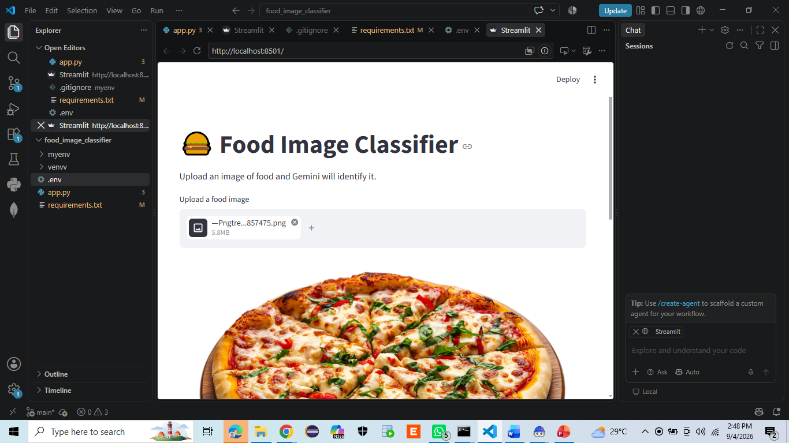
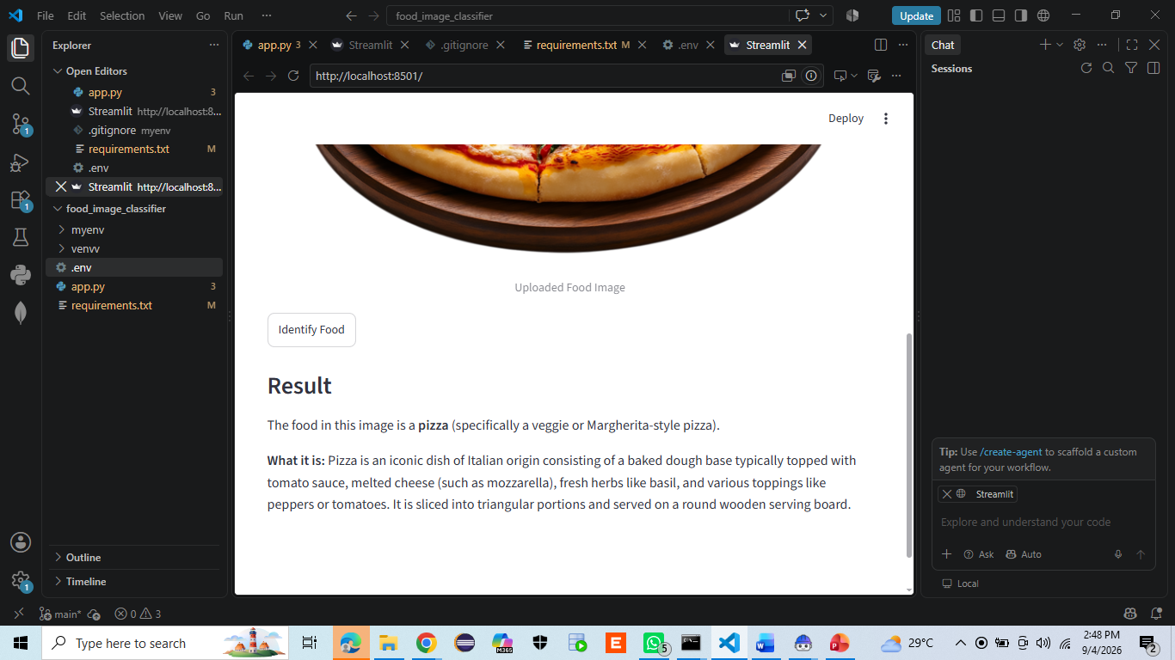
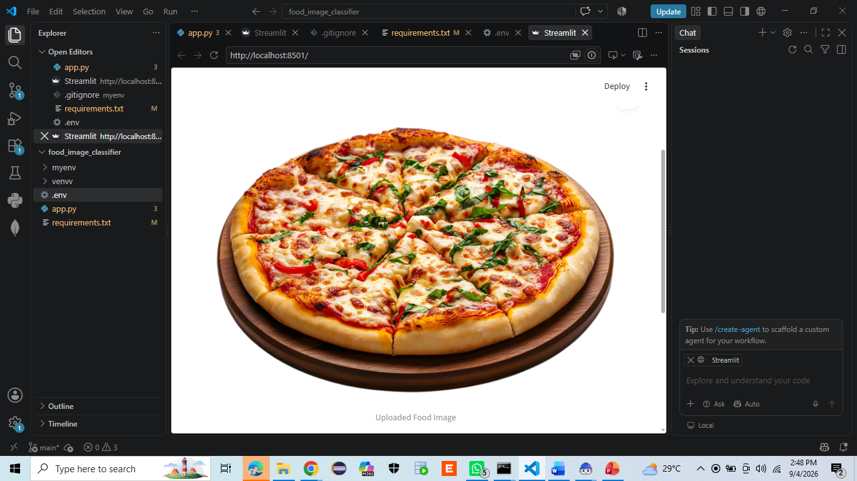
Result

Slide 9
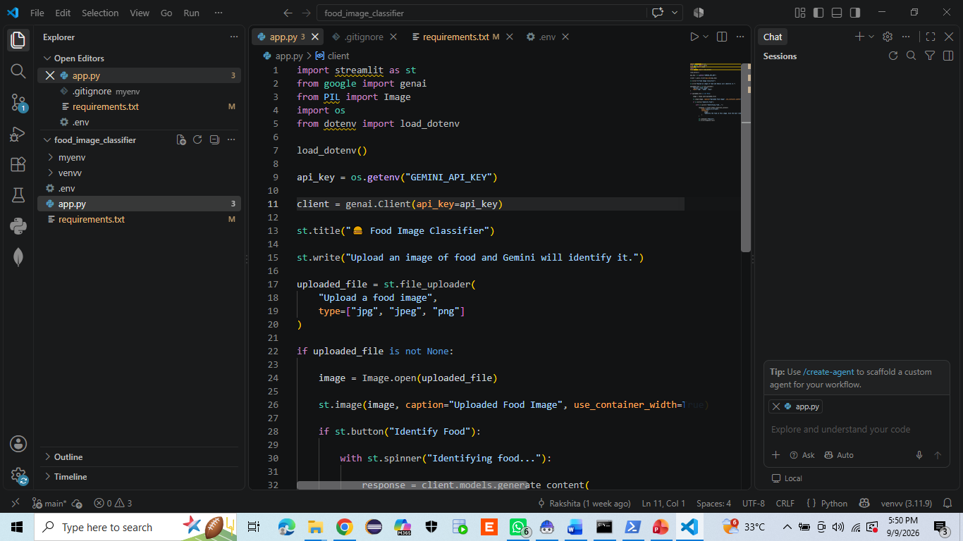
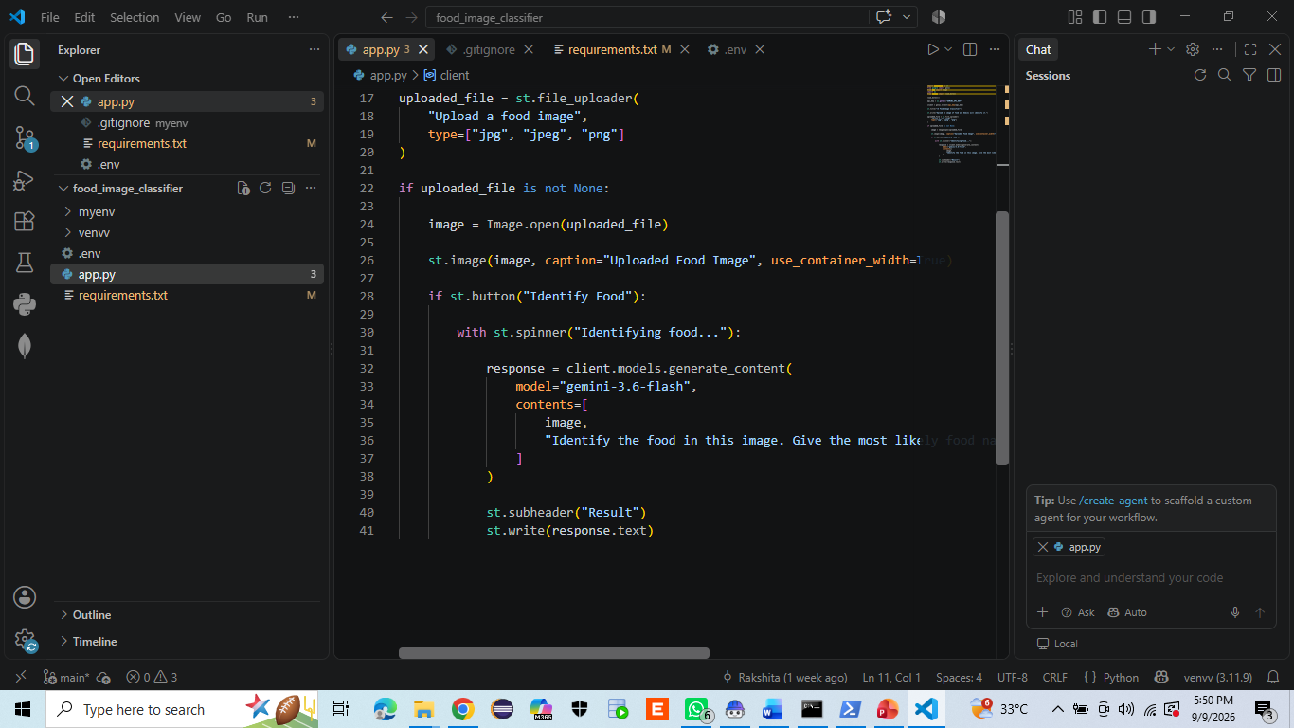
RESULT

Slide 10
Conclusion
The Food Image Classifier project successfully demonstrates how Generative AI can be used to identify food items from images. In this project, I uploaded a pizza image, and the model analyzed the image and correctly identified it as pizza. This project helped me understand the practical use of AI for image classification and how users can interact with an AI model through a simple application. Overall, the project shows that AI-based food recognition can be useful for applications such as food identification, restaurant systems, dietary analysis, and smart food applications.

Slide 11
Future scope
. In the future, this system can be enhanced into an intelligent food-recognition platform with real-time identification and nutritional analysis.

Slide 12
References
1. Google Gemini API Documentation – For understanding Gemini AI and image analysis.
2. Google GenAI Python SDK Documentation – For integrating Gemini with the Python application.
3. Streamlit Documentation – For developing and deploying the web application.
4. Python Documentation – For Python programming and application development.
5. Pillow Documentation – For image loading and processing.
6. GitHub Documentation – For project version control and repository management.
7. OpenAI ChatGPT – Used as an AI-assisted learning and development resource during project development.

Slide 13
Deployment link / github link
Github Link: https://github.com/rakshitathakre26-lgtm/food-image-classifier.git
Deployment: HF, Streamlit Link, Gradio (OPTIONAL)
Streamlit

Slide 14
THANK YOU

